Slide 1
Covid-19 Discussions on Twitter: Identifying Key Issues
Mike Thelwall
Statistical Cybermetrics and Research Evaluation Group
University of Wolverhampton, UK
m.thelwall@wlv.ac.uk
With thanks to co-authors Kayvan Kousha and Saheeda Thelwall

Slide 2
Overview: Summaries of four journal articles
A thematic analysis of highly retweeted early Covid-19 tweets: Consensus, information, dissent, and lockdown life.
Covid-19 vaccine hesitancy on English-language Twitter.
Cures, treatments and vaccines for Covid-19: International differences in interest on Twitter.
Can Twitter give insights into international differences in Covid-19 vaccination? Eight countries’ English tweets to 21 March 2021.

Slide 3
Article goals and rationales
Find which issues resonated on Twitter at the start of Covid-19 to get insights into public responses.
Find how Covid-19 vaccine hesitancy was discussed to help combat it.
Check for international differences in interest about cures, treatments and vaccines for Covid-19 to get insights into how countries reacted differently.
Identify international differences in how Covid-19 vaccination is tweeted about to help encourage it.
The common theme is exploring public reactions to Covid-19.

Slide 4
Article data
Highly retweeted early Covid-19 tweets.
Tweets suggesting Covid-19 vaccine hesitancy.
Tweets about cures, treatments and vaccines for Covid-19.
Tweets about Covid-19 vaccines.
All collected with the free software Mozdeh https://mozdeh.wlv.ac.uk/ with a set of Covid-19 keyword queries. Duplicate tweets always eliminated by Mozdeh.
Three studies harnessed the same ongoing collection of Covid-19 tweets; one collected tweets retrospectively with the Twitter API for Academic research.

Slide 5
Why Twitter? And other Questions
Why not Instagram, Facebook, WhatsApp or Weibo?
Data access: Twitter allows researchers to harvest its data and the others don’t (except Weibo if you are in China?)
Why not surveys, focus groups or interviews?
Speed: Twitter data allows rapid-response studies and international comparisons.
What about people that don’t tweet?
Limitation: This is an unavoidable biasing factor.
What about ethics?
Tweets are fully public so arguably don’t need informed consent to study, but should not be quoted unless from public figures.

Slide 6
Article methods
Thematic analysis (Braun & Clarke)
Content analysis (Neuendorf)
Quantitative descriptive methods: Time series graphs, supported by correlation tests.
Word association thematic analysis (WATA).

Slide 7
Study 1: A thematic analysis of highly retweeted early Covid-19 tweets
Goal: Find which issues resonated on Twitter at the start of Covid-19 (March 10-29, 2020) to get insights into public responses.
Data: 87 English-language tweets retweeted at least 100,000 times each containing: coronavirus, COVID-19, COVID19, or “corona virus”.
Method: A reflexive thematic analysis to group the tweets into themes reflecting common topics or purposes.
Repeatedly read the tweets, tagged them with potential themes, clustered the themes together, & attempted to merge/split themes when necessary.

Slide 8
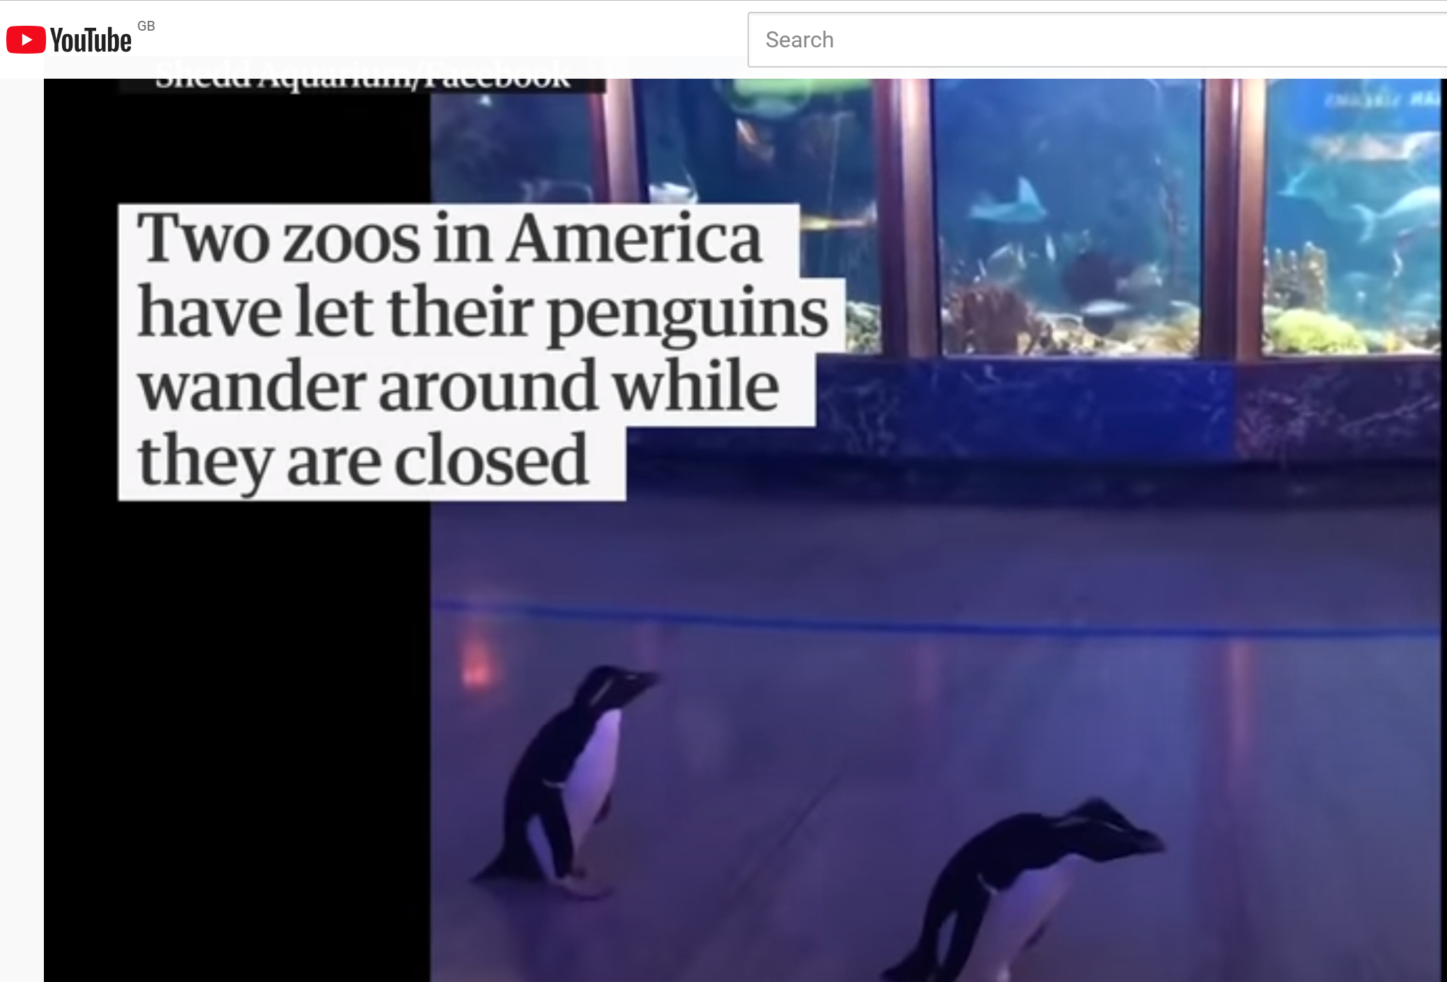
Study 1 Results: Main theme
Lockdown life: Coping with or laughing at sudden self-isolation, lockdown or social distancing rules.
These are mainly lighthearted human-interest stories or anecdotes that nevertheless resonated strongly – some from the mainstream media, others not. Many were about animals, children or jokes.

Slide 9
Study 1 Results: Other themes
Attitude towards social restrictions: and fears about the seriousness of the threat, sometimes expressed with humour (e.g., K-pop fans will cure it as soon as it infects their idol).
Politics: Mainly criticizing government actions.
Covid-19 Safety messages
People with Covid-19: Which celebrities; what it’s like to have it.
Support for key workers
Work: Coping with suddenly working from home.
Covid-19 symptom facts/news.

Slide 10
Study 1 Conclusions
From an information behaviour perspective, Twitter did not seem to be mainly used for sharing Covid-19 information.
Instead, it seemed to be more used for psychologically coping with the new situation.
It also platformed opposition to dominant political narratives.

Slide 11
Study 2: Covid-19 vaccine hesitancy on English-language Twitter
Goal: Find how Covid-19 vaccine hesitancy was discussed to help combat it.
Data: 446 random tweets from 10 March to 5 December 2020 matching: (coronavirus, COVID-19, COVID19, or “corona virus”) AND (vaccine, vaccines, vaccination, vaccinations, vaccinating, or vaccinated); AND manually judged to be about vaccine hesitancy.
Method: Inductive content analysis: Manually categorised the tweets into a set of categories identified from a first reading of the tweets (two coders, moderate Cohen’s kappa agreement: 0.537).

Slide 12
Study 2 Results (10 March to 5 December 2020)
Categories | Tweets
Vaccines are a conspiracy | 105 (24%)
Vaccines too “rushed” | 72 (16%)
Vaccines could be unsafe | 47 (11%)
Vaccines may not work | 37 (8.3%)
Survey/poll: who will take a COVID-19 vaccine | 28 (6.3%)
No reason given for vaccine hesitancy | 25 (5.6%)
Joke | 20 (4.5%)
Russian vaccines problematic | 20 (4.5%)
Vaccines may be a threat/risk to Black people | 16 (3.6%)
Survey results | 16 (3.6%)
Against vaccines developed with foetal tissue | 11 (2.5%)
Persuasion: The importance of widespread vaccination | 10 (2.2%)
Chinese vaccines problematic | 8 (1.8%)
Other: Anything else or unclear. | 31 (7.0%)

Slide 13
Study 2 Conclusions
Widespread interest in conspiracy theories and concerns about vaccines being unsafe or rushed.
These needed addressing to ensure high vaccine uptake.

Slide 14
Study 3: International differences in cure, treatment and vaccine interest on Twitter
Goal: Investigate interest about cures, treatments and vaccines for Covid-19 to get insights into how countries reacted differently.
Data: January 2020 to 8 April 2021 tweets containing: coronavirus, COVID-19, COVID19, or “corona virus”.
Method: (Quantitative descriptive) Time series graphs, supported by correlation tests.

Slide 15
Study 3 Results: Trends 2020 - April 2021
Percent of all English Covid-19 tweets

Slide 16
Study 3 Results: National cure trends
Sporadic spikes in interest in cures internationally, with chloroquine being prominent in the USA and Nigeria.
Larger international differences underly this.
Percent of Covid tweets mentioning cures

Slide 17
Study 3 Results: National vaccine trends
Percent of Covid tweets mentioning vaccines

Slide 18
Study 3 Results: Vaccine interest vs. HDI
There was only a slight tendency for countries with a higher Human Development Index to tweet more about vaccines (r=0.1) even though richer countries got them first.
Percent of vaccine-related Covid-19 tweets from country
Where is China?
On Weibo, not Twitter

Slide 19
Study 3 Conclusions
No major theoretical insights but pointers to some international differences in beliefs about cures and interest in vaccines.
[I liked the graphs (more in the paper) but am a bit disappointed about the results overall.]

Slide 20
Study 4: International differences in Covid-19 vaccination tweets
Goal: Identify international differences in how Covid-19 vaccination is tweeted about to help encourage it.
Data: 5,789,082 tweets from 5 December 2020 to 21 March 2021 matching: vaccine, vaccination, vaccinating, vaccinated, CovidVaccination, CovidVaccine, OR CovidVaccineFacts.
Method: Word association thematic analysis (WATA) to detect words that are statistically significantly more likely to be in the tweets of one country compared to the others; followed by a thematic analysis of the words found. For 10 countries.

Slide 21
Study 4 Methods
The diagram on the right illustrates WATA for the USA.
This was repeated for the other countries.

Slide 22
Study 4 Results (sample themes by country)
USA: The need for vaccination before in-person working; the need for Covid-19 economic relief. Vaccine hesitancy in the Black community.
Canada: Vaccine mistrust amongst indigenous Canadians.
India: Vaccination rollout arrangements. Vaccine kindness (#VaccineMaitri) - shipping vaccines to other countries. (no mention of Scheduled Castes and Scheduled Tribes)
UK: Positive terms (e.g., fantastic, lovely, brilliant, pleased). The US was excited to get a vaccine and Ireland was delighted to get a vaccine. Vaccine hesitancy in the Black And Minority Ethnic (BAME) community.

Slide 23
Study 4 Results: Experts in the top 100 terms
@jkwan_md
Canada: Five: e.g., Dr. Jennifer Kwan’s family physician perspective.
Ireland: Four: e.g., university immunologist Prof. Luke O’Neil, tweeting science and information; Two university presidents tweeting science.
Nigeria: Two: e.g., Dr Chinonso Egemba, leveraging social media for health education.
South Africa: One: Prof Mosa Moshabela, Deputy Vice-Chancellor, medical specialist and medical practitioner.
UK: Chair of Global Public Health Prof. Devi Sridhar at term 174.
India: Faheem Younus, MD, Chief of Infectious Diseases at the University of Maryland (USA) at term 310.
USA: No experts in the top 500 terms.
@MoshabelaMosa

Slide 24
Study 4 Conclusions
Vaccine fear amongst disadvantaged groups is an international problem.
The differing international relevance of independent medical experts is a potential concern given that coherent public health messages are necessary for vaccination programs.
Governments should consider harnessing apparently influential commenters on social media, or directly combatting their misinformation when they are unreliable.
The unique vaccine kindness concept, #VaccineMaitri, from India may encourage more equitable international sharing?

Slide 25
Overall conclusions
Differences, commonalities, advantages, disadvantages
The four studies had different:
Goals
Types of sample from Twitter
Methods
The four studies had the same:
Type of data (tweets) and collection software (Mozdeh)
Focus on descriptive rather then theory-driven goals
Language focus (English)
The advantage of Twitter was:
Fast data collection, allowing early studies, including international scope
The disadvantage of Twitter was:
Missing demographics and missing context from tweets (very short)

Slide 26
References
Thelwall, M. & Thelwall, S. (2020). A thematic analysis of highly retweeted early COVID-19 tweets: Consensus, information, dissent, and lockdown life. Aslib Journal of Information Management, 72(6), 945-962. https://doi.org/10.1108/AJIM-05-2020-0134
Thelwall, M. (2021). Cures, treatments and vaccines for Covid-19: International differences in interest on Twitter. Journal of Altmetrics, 4(1), 4. https://doi.org/10.29024/joa.42
Thelwall, M., Kousha, K. & Thelwall, S. (2021). Covid-19 vaccine hesitancy on English-language Twitter. Profesional de la Información. 30(2), e300212. https://doi.org/10.3145/epi.2021.mar.12
Thelwall, M. (2021). Can Twitter give insights into international differences in covid-19 vaccination? Eight countries’ English tweets to 21 March 2021. Profesional de la Información. 30(3), e300311. https://doi.org/10.3145/epi.2021.may.11
Thelwall, M. (2021). Word association thematic analysis: A social media text exploration strategy. San Rafael, CA: Morgan & Claypool.

